Slide 1
Classes

Slide 2
Java Classes
A class in Java is a set of objects which shares common characteristics/ behavior and common properties/ attributes.
It is a user-defined blueprint or prototype from which objects are created.
For example, Student is a class while a particular student named Ravi is an object.

Slide 3
Properties of Java Classes
Class is not a real-world entity. It is just a template or blueprint or prototype from which objects are created.
Class does not occupy memory.
Class is a group of variables of different data types and a group of methods.
A Class in Java can contain:
Data member
Method
Constructor
Nested Class
Interface

Slide 4
Class Declaration in Java
access_modifier class <class_name>
{
data member;
method;
constructor;
nested class;
interface;
}

Slide 5
/* A program that uses the Box class.
Call this file BoxDemo.java
*/
class Box {
double width;
double height;
double depth;
}
// This class declares an object of type Box.
class BoxDemo {
public static void main(String args[]) {
Box mybox = new Box();
double vol;
// assign values to mybox's instance variables
mybox.width = 10;
mybox.height = 20;
mybox.depth = 15;
// compute volume of box
vol = mybox.width * mybox.height * mybox.depth;
System.out.println("Volume is " + vol);
}
}

Slide 6
// This program includes a method inside the box class.
class Box {
double width;
double height;
double depth;
// display volume of a box
void volume() {
System.out.print("Volume is ");
System.out.println(width * height * depth);
}
}
class BoxDemo3 {
public static void main(String args[]) {
Box mybox1 = new Box();
Box mybox2 = new Box();
// assign values to mybox1's instance variables
mybox1.width = 10;
mybox1.height = 20;
mybox1.depth = 15;
/* assign different values to mybox2's
instance variables */
mybox2.width = 3;
mybox2.height = 6;
mybox2.depth = 9;
// display volume of first box
mybox1.volume();
// display volume of second box
mybox2.volume();
}
}

Slide 7
// Now, volume() returns the volume of a box.
class Box {
double width;
double height;
double depth;
// compute and return volume
double volume() {
return width * height * depth;
}
}
class BoxDemo4 {
public static void main(String args[]) {
Box mybox1 = new Box();
Box mybox2 = new Box();
double vol;
// assign values to mybox1's instance variables
mybox1.width = 10;
mybox1.height = 20;
mybox1.depth = 15;
/* assign different values to mybox2's
instance variables */
mybox2.width = 3;
mybox2.height = 6;
mybox2.depth = 9;
// get volume of first box
vol = mybox1.volume();
System.out.println("Volume is " + vol);
// get volume of second box
vol = mybox2.volume();
System.out.println("Volume is " + vol);
}
}

Slide 8
// This program uses a parameterized method.
class Box {
double width;
double height;
double depth;
// compute and return volume
double volume() {
return width * height * depth;
}
// sets dimensions of box
void setDim(double w, double h, double d) {
width = w;
height = h;
depth = d;
}
}
class BoxDemo5 {
public static void main(String args[]) {
Box mybox1 = new Box();
Box mybox2 = new Box();
double vol;
// initialize each box
mybox1.setDim(10, 20, 15);
mybox2.setDim(3, 6, 9);
// get volume of first box
vol = mybox1.volume();
System.out.println("Volume is " + vol);
// get volume of second box
vol = mybox2.volume();
System.out.println("Volume is " + vol);
}
}

Slide 9
Constructors
A constructor initializes an object immediately upon creation.
It has the same name as the class in which it resides and is syntactically similar to a method.
Once defined, the constructor is automatically called when the object is created, before the new operator completes.
Constructors have no return type, not even void.
This is because the implicit return type of a class’ constructor is the class type itself.
It is the constructor’s job to initialize the internal state of an object so that the code creating an instance will have a fully initialized, usable object immediately.

Slide 10
class Box {
double width;
double height;
double depth;
// This is the constructor for Box.
Box() {
System.out.println("Constructing Box");
width = 10;
height = 10;
depth = 10;
}
// compute and return volume
double volume() {
return width * height * depth;
}
}
class BoxDemo6 {
public static void main(String args[]) {
// declare, allocate, and initialize Box objects
Box mybox1 = new Box();
Box mybox2 = new Box();
double vol;
// get volume of first box
vol = mybox1.volume();
System.out.println("Volume is " + vol);
// get volume of second box
vol = mybox2.volume();
System.out.println("Volume is " + vol);
}
}

Slide 11
Parameterized Constructors
class Box {
double width;
double height;
double depth;
// This is the constructor for Box.
Box(double w, double h, double d) {
width = w;
height = h;
depth = d;
}
// compute and return volume
double volume() {
return width * height * depth;
}
}
class BoxDemo7 {
public static void main(String args[]) {
// declare, allocate, and initialize Box objects
Box mybox1 = new Box(10, 20, 15);
Box mybox2 = new Box(3, 6, 9);
double vol;
// get volume of first box
vol = mybox1.volume();
System.out.println("Volume is " + vol);
// get volume of second box
vol = mybox2.volume();
System.out.println("Volume is " + vol);
}
}

Slide 12
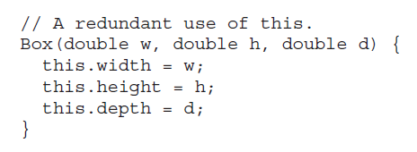
The this Keyword
Sometimes a method will need to refer to the object that invoked it.
To allow this, Java defines the this keyword. this can be used inside any method to refer to the current object.
That is, this is always a reference to the object on which the method was invoked.
You can use this anywhere a reference to an object of the current class’ type is permitted.
To better understand what this refers to, consider the following version of Box( ):

Slide 13
Overloading Methods
In Java, it is possible to define two or more methods within the same class that share the same name, as long as their parameter declarations are different.
When this is the case, the methods are said to be overloaded, and the process is referred to as method overloading.
Method overloading is one of the ways that Java supports polymorphism.
When an overloaded method is invoked, Java uses the type and/or number of arguments as its guide to determine which version of the overloaded method to actually call.
Thus, overloaded methods must differ in the type and/or number of their parameters.
While overloaded methods may have different return types, the return type alone is insufficient to
distinguish two versions of a method.
When Java encounters a call to an overloaded method, it simply executes the version of the method whose parameters match the arguments used in the call.

Slide 14
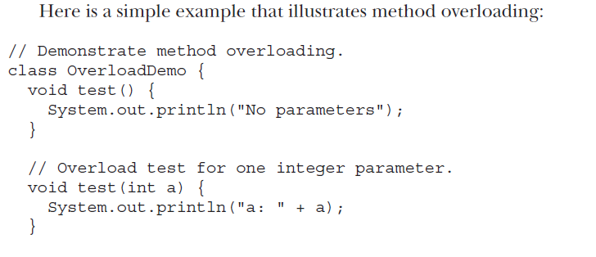
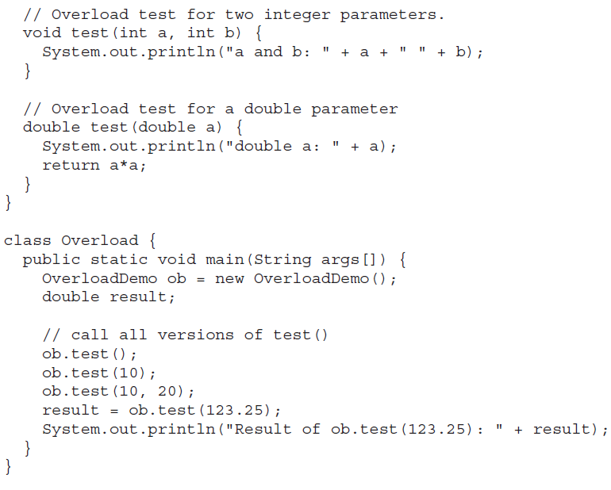

Slide 15
// Demonstrate method overloading.
class OverloadDemo {
void test() {
System.out.println("No parameters");
}
// Overload test for one integer parameter.
void test(int a) {
System.out.println("a: " + a);
}
// Overload test for two integer parameters.
void test(int a, int b) {
System.out.println("a and b: " + a + " " + b);
}
// Overload test for a double parameter
double test(double a) {
System.out.println("double a: " + a);
return a*a;
}
}
class Overload {
public static void main(String args[]) {
OverloadDemo ob = new OverloadDemo();
double result;
// call all versions of test()
ob.test();
ob.test(10);
ob.test(10, 20);
result = ob.test(123.25);
System.out.println("Result of ob.test(123.25): " + result);
}
}

Slide 16
Overloading Constructors
// compute and return volume
double volume() {
return width * height * depth;
}
}
class OverloadCons {
public static void main(String args[]) {
// create boxes using the various constructors
Box mybox1 = new Box(10, 20, 15);
Box mybox2 = new Box();
Box mycube = new Box(7);
double vol;
// get volume of first box
vol = mybox1.volume();
System.out.println("Volume of mybox1 is " + vol);
// get volume of second box
vol = mybox2.volume();
System.out.println("Volume of mybox2 is " + vol);
// get volume of cube
vol = mycube.volume();
System.out.println("Volume of mycube is " + vol);
}
}
class Box {
double width;
double height;
double depth;
// constructor used when all dimensions specified
Box(double w, double h, double d) {
width = w;
height = h;
depth = d;
}
// constructor used when no dimensions specified
Box() {
width = -1; // use -1 to indicate
height = -1; // an uninitialized
depth = -1; // box
}
Box(double len) {
width = height = depth = len;
}

Slide 17
Using Objects as Parameters
// Objects may be passed to methods.
class Test {
int a, b;
Test(int i, int j) {
a = i;
b = j;
}
// return true if o is equal to the invoking object
boolean equalTo(Test o) {
if(o.a == a && o.b == b) return true;
else return false;
}
}
class PassOb
{
public static void main(String args[])
{
Test ob1 = new Test(100, 22);
Test ob2 = new Test(100, 22);
Test ob3 = new Test(-1, -1);
System.out.println("ob1 == ob2: " + ob1.equalTo(ob2));
System.out.println("ob1 == ob3: " + ob1.equalTo(ob3));
}
}

Slide 18
This program generates the following output:
ob1 == ob2: true
ob1 == ob3: false

Slide 19
class Box {
double width;
double height;
double depth;
// Notice this constructor. It takes an object of type Box.
Box(Box ob) { // pass object to constructor
width = ob.width;
height = ob.height;
depth = ob.depth;
}
// constructor used when all dimensions specified
Box(double w, double h, double d) {
width = w;
height = h;
depth = d;
}
// constructor used when no dimensions specified
Box() {
width = -1; // use -1 to indicate
height = -1; // an uninitialized
depth = -1; // box
}

Slide 20
// constructor used when cube is created
Box(double len) {
width = height = depth = len;
}
// compute and return volume
double volume() {
return width * height * depth;
}
}
class OverloadCons2 {
public static void main(String args[]) {
// create boxes using the various constructors
Box mybox1 = new Box(10, 20, 15);
Box mybox2 = new Box();
Box mycube = new Box(7);
Box myclone = new Box(mybox1); // create copy of mybox1
double vol;
// get volume of first box
vol = mybox1.volume();
System.out.println("Volume of mybox1 is " + vol);
// get volume of second box
vol = mybox2.volume();
System.out.println("Volume of mybox2 is " + vol);
// get volume of cube
vol = mycube.volume();
System.out.println("Volume of cube is " + vol);
// get volume of clone
vol = myclone.volume();
System.out.println("Volume of clone is " + vol);
}
}

Slide 21
A Closer Look at Argument Passing
In general, there are two ways that a computer language can pass an argument to a subroutine.
The first way is call-by-value.
This approach copies the value of an argument into the formal parameter of the subroutine. Therefore, changes made to the parameter of the subroutine have no effect on the argument.
The second way an argument can be passed is call-by-reference.
In this approach, a reference to an argument (not the value of the argument) is passed to the parameter.
Inside the subroutine, this reference is used to access the actual argument specified in the call. This means that changes made to the parameter will affect the argument used to call the subroutine.

Slide 22
// Primitive types are passed by value.
class Test {
void meth(int i, int j) {
i *= 2;
j /= 2;
}
}
class CallByValue {
public static void main(String args[]) {
Test ob = new Test();
int a = 15, b = 20;
System.out.println("a and b before call: " + a + " " + b);
ob.meth(a, b);
System.out.println("a and b after call: " + a + " " + b);
}
}

Slide 23
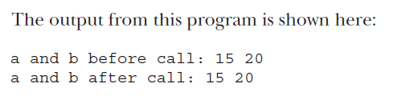

Slide 24
// Objects are passed through their references.
class Test {
int a, b;
Test(int i, int j) {
a = i;
b = j;
}
void meth(Test o) {
o.a *= 2;
o.b /= 2;
}
}
class PassObjRef {
public static void main(String args[]) {
Test ob = new Test(15, 20);
System.out.println("ob.a and ob.b before call: " + ob.a + " " + ob.b);
ob.meth(ob);
System.out.println("ob.a and ob.b after call: " + ob.a + " " + ob.b);
}
}

Slide 25
Recursion
Java supports recursion. Recursion is the process of defining something in terms of itself.
Recursion is the attribute that allows a method to call itself.
A method that calls itself is said to be recursive.
The classic example of recursion is the computation of the factorial of a number. The factorial of a number N is the product of all the whole numbers between 1 and N.
For
example, 3 factorial is 1 × 2 × 3 ×, or 6. Here is how a factorial can be computed by use
of a recursive method:

Slide 26
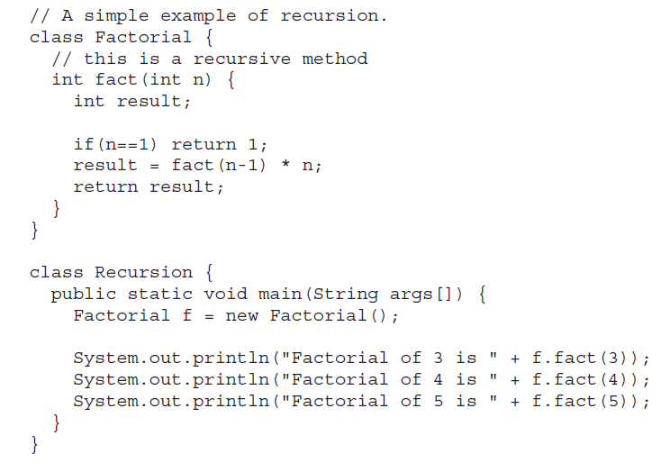

Slide 27
Introducing Access Control
As you know, encapsulation links data with the code that manipulates it.
However, encapsulation provides another important attribute: access control.
Through encapsulation, you can control what parts of a program can access the members of a class.
By controlling access, you can prevent misuse.
For example, allowing access to data only through a well defined set of methods, you can prevent the misuse of that data.
Thus, when correctly implemented, a class creates a “black box” which may be used, but the inner workings of which are not open to tampering

Slide 28
Java’s access modifiers are public, private, and protected.
Java also defines a default access level. protected applies only when inheritance is involved.
public and private
When a member of a class is modified by public, then that member can be accessed by any other code.
When a member of a class is specified as private, then that member can only be accessed by other members of its class.
That’s why main( ) has always been preceded by the public modifier.
It is called by code that is outside the program—that is, by the Java run-time system.
When no access modifier is used, then by default the member of a class is public within its own package, but cannot be accessed outside of its package.

Slide 29
An access modifier precedes the rest of a member’s type specification. That is, it must begin a member’s declaration statement.
Here is an example:
public int i;
private double j;
private int myMethod(int a, char b) { //...

Slide 30
To understand the effects of public and private access, consider the following program:
/* This program demonstrates the difference between public and private.*/
class Test {
int a; // default access
public int b; // public access
private int c; // private access
// methods to access c
void setc(int i) { // set c's value
c = i;
}
int getc() { // get c's value
return c;
}
}

Slide 31
class AccessTest {
public static void main(String args[]) {
Test ob = new Test();
// These are OK, a and b may be accessed directly
ob.a = 10;
ob.b = 20;
// This is not OK and will cause an error
// ob.c = 100; // Error!
// You must access c through its methods
ob.setc(100); // OK
System.out.println("a, b, and c: " + ob.a + " " +
ob.b + " " + ob.getc());
}
}

Slide 32
Understanding static
There will be times when you will want to define a class member that will be used independently of any object of that class.
Normally, a class member must be accessed only in conjunction with an object of its class.
However, it is possible to create a member that can be used by itself, without reference to a specific instance.
To create such a member, precede its declaration with the keyword static.
When a member is declared static, it can be accessed before any objects of its class are created, and without reference to any object.
You can declare both methods and variables to be static.
The most common example of a static member is main( ). main( ) is declared as static because it must be called before any objects exist.
Instance variables declared as static are, essentially, global variables.
When objects of its class are declared, no copy of a static variable is made. Instead, all instances of the class share the same static variable.

Slide 33
Methods declared as static have several restrictions:
• They can only directly call other static methods.
• They can only directly access static data.
• They cannot refer to this or super in any way.
if you wish to call a static method from outside its class, you can do so using the following general form
classname.method( )
Here, classname is the name of the class in which the static method is declared

Slide 34
class StaticDemo {
static int a = 42;
static int b = 99;
static void callme() {
System.out.println("a = " + a);
}
}
class StaticByName {
public static void main(String args[]) {
StaticDemo.callme();
System.out.println("b = " + StaticDemo.b);
}
}

Slide 35
final
A field can be declared as final.
Doing so prevents its contents from being modified, making it, essentially, a constant.
This means that you must initialize a final field when it is declared.
You can do this in one of two ways: First, you can give it a value when it is
declared. Second, you can assign it a value within a constructor.
The first approach is the most common. Here is an example:
final int FILE_NEW = 1;
final int FILE_OPEN = 2;
final int FILE_SAVE = 3;
It is a common coding convention to choose all uppercase identifiers for final fields,

